Slide 1
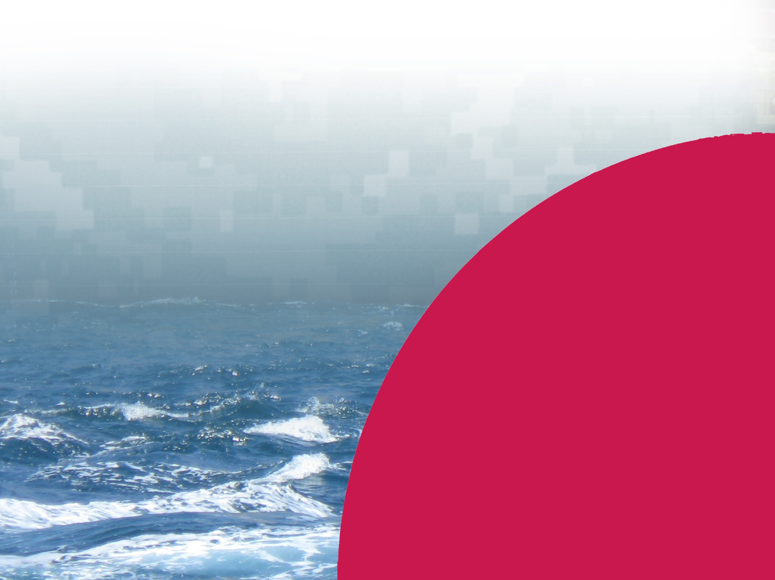
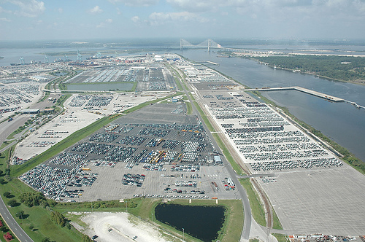
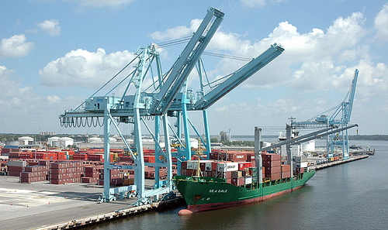
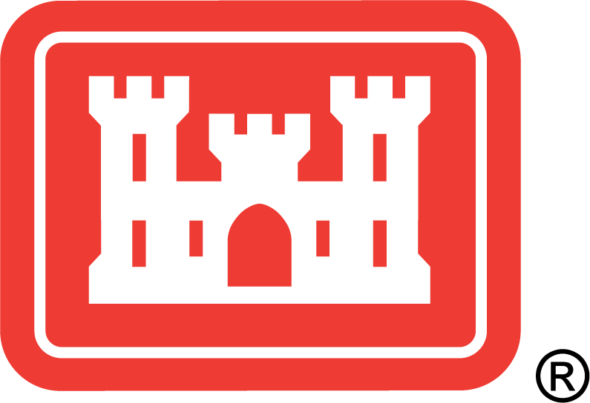
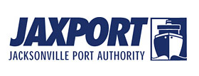
JACKSONVILLE HARBOR
Jacksonville Harbor Deepening Study
Discussion: Confined Blasting
March 12, 2013
BUILDING STRONG®
US ARMY CORPS OF ENGINEERS | Jacksonville District

Slide 2
PRESENTATION OUTLINE
Why Consider Deepening the Channel?
Where Would The Deepening Occur?
USACE Recommended Depth
JAXPORT Locally Preferred Plan (LPP)
What’s The Timeline?
Confined Blasting Presentation
PRESENTERS:
Jason Harrah, Project Manager
Terri Jordan-Sellers, Senior Biologist
BUILDING STRONG®
US ARMY CORPS OF ENGINEERS | Jacksonville District

Slide 3
WHY CONSIDER DEEPENING?
Problem: Transportation Cost Inefficiency
Navigation concerns include two main problems:
Insufficient Federal Channel Depths
Restrictive Channel Widths and Turning Basins
Opportunity: Reduce Transportation Costs
More Efficient Transportation of Cargo
Increased Navigational Safety
Opportunity to Capitalize on Larger Vessel Calls
BUILDING STRONG®
US ARMY CORPS OF ENGINEERS | Jacksonville District

Slide 4
WHERE WOULD DEEPENING OCCUR?
Note: Not all areas of deepening require blasting
Segment 1: Entrance Channel to Mile 14 (Reduced to ~ Mile 13)
Segment 2: Mile 14 to 20 (eliminated)
Segment 3: West Blount Island Channel (Cuts F&G) (eliminated)
MILE 14
OIL TERMINALS
JEA TERMINALS
U.S. NAVY TERMINALS
MOL TERMINALS
JPA BLOUNT ISLAND TERMINALS
JPA BULK TERMINALS
MAYPORT NAVY TERMINALS
OIL TERMINALS
MILE 13
JPA TALLEYRAND TERMINALS

Slide 5
DISCUSSION ON CHANNEL DEPTHS
USACE Recommended Depth – 45 feet
Provides transition to larger vessels
Port improvements needed beyond 45’
JAXPORT Locally Preferred Plan – 47 feet
Must be approved by Assistant Secretary of the Army (Civil Works)
Additional depths beyond 45’ paid 100% by sponsor
Benefits are seen beyond 45’ – however cost growth is significant
BUILDING STRONG®
US ARMY CORPS OF ENGINEERS | Jacksonville District

Slide 6
PROJECT TIMELINE President’s “We Can’t Wait Initiative”
ACTIVITY | DATES
Completion of Draft Report w/SEIS | April 2013
Concurrent Reviews: Public, Legal, Agency Technical Review, Policy (Division and Headquarters), Independent External Peer Review | May - July 2013
Division Engineer Approval Design Initiated | October 2013
Civil Works Review Board | December 2013
Chief’s Report | April 2014
Authorization/Funding/Construction | 2015 ?

Slide 7
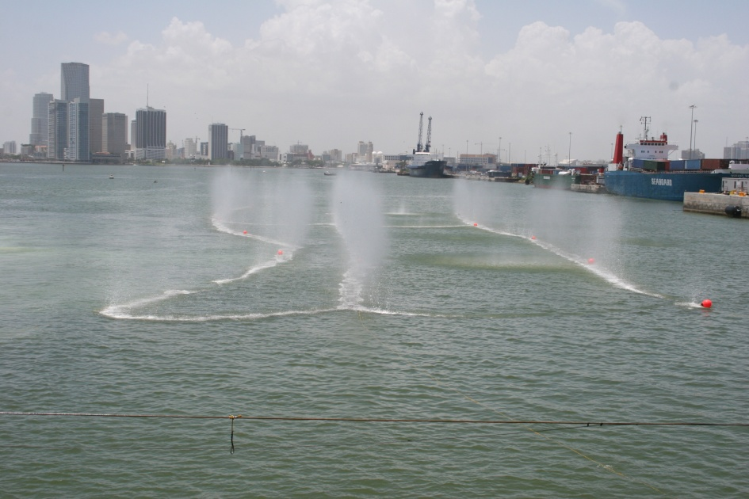
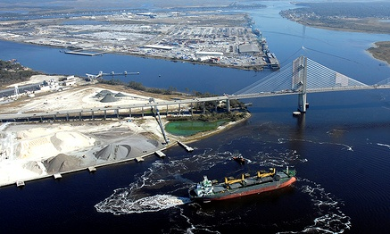
JACKSONVILLE HARBOR
Jacksonville Harbor Deepening Study Confined Blasting: Miami Harbor Case History
Presented by:
Terri Jordan-Sellers
Biologist, Environmental Branch Planning Division
March 12, 2012
BUILDING STRONG®
US ARMY CORPS OF ENGINEERS | Jacksonville District

Slide 8
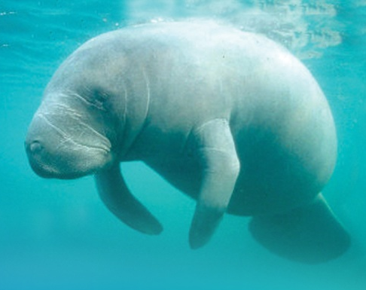
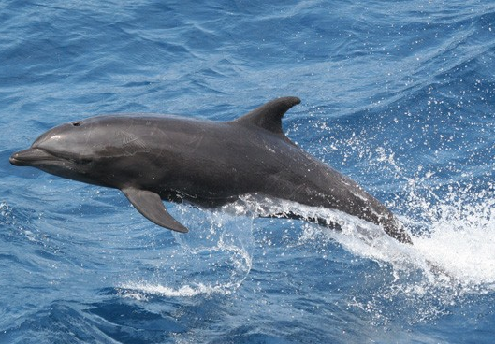
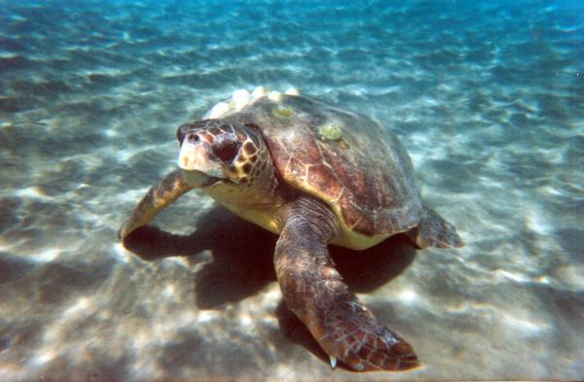
THE ISSUE
How does the Corps and its contractors meet a Congressional mandate to deepen a port in an extremely environmentally sensitive area?
What is sensitive?
Seagrass
Coral Reefs (directly offshore)
National Park to the south
Entire bay is “Outstanding State Waters”
State Aquatic Preserve
Critical Wildlife Area directly adjacent
Endangered, threatened and protected species
Highly aware citizenry and city overlooks project site

Slide 9
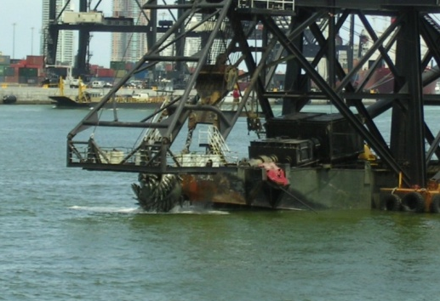
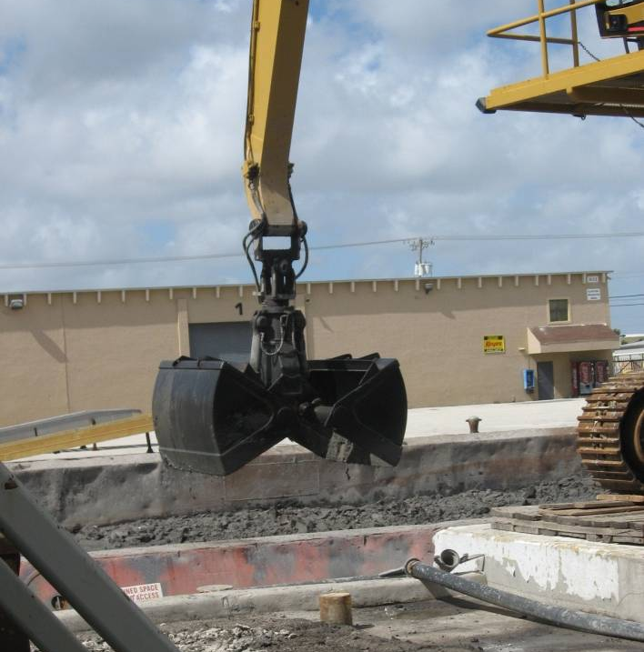
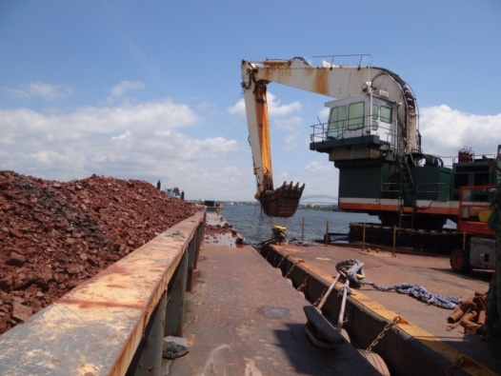
CONSTRUCTION TECHNIQUES
9
Substrate hardness requires blasting in areas
Previous blasting in early 1980s
Confined blasting, w/stemming; “Navy diver” protection radii – (e.g., Port of Miami, May 2005/2013-2014)
Cutterhead dredge
Clamshell dredge
Hopper dredge
Bucket dredge

Slide 10
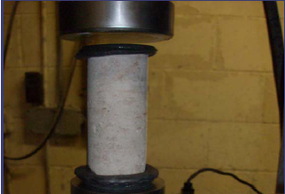
BLASTING REQUIREMENT
10
The amount of blasting will be contractor dependent
Some dredging equipment will not require as much pre-treatment of rock as others AND will be evaluated during the bid/proposal process
Port Everglades Unconfined Compressive Strengths
massive geologic units underlying the dredge area
UCS TESTS FOR PORT EVERGLADES RANGE FROM 266 PSI TO 12806 PSI

Slide 11
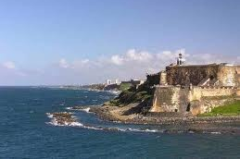
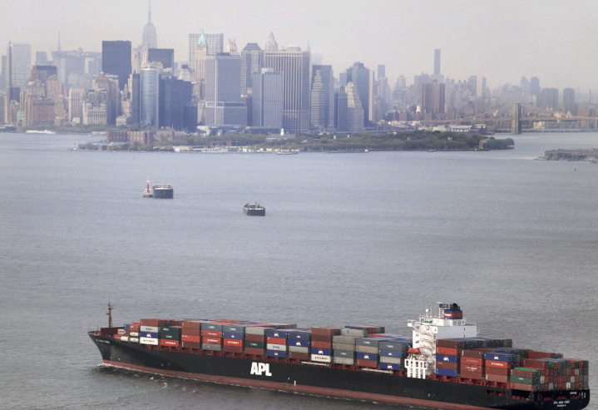
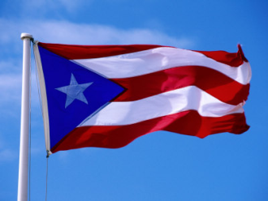
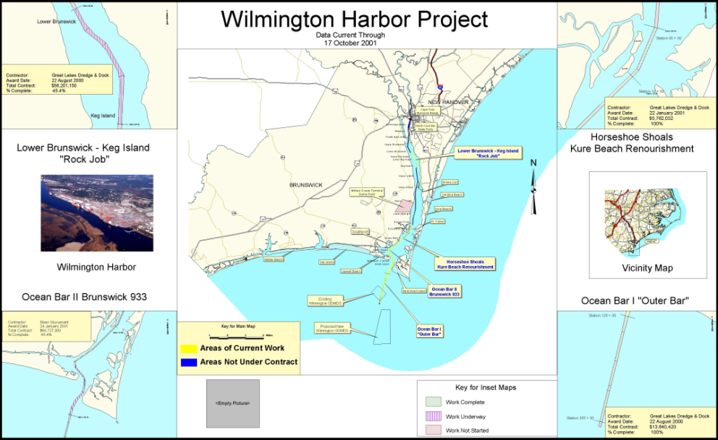
CONFINED BLASTING HISTORY
11
San Juan Harbor, 2000
New York Harbor, 2004-2013
Wilmington Harbor, 2002
Miami Harbor, 2005
Notes:
San Juan Harbor, Puerto Rico – 2000
Wilmington Harbor, NC – 2002
New York Harbor, NY – 2004-2013 (still ongoing)
Also Boston Harbor; Columbia River, OR

Slide 12
PROJECT AREA: MIAMI HARBOR
MIAMI HARBOR – PHASE II
1989 EIS estimated 250 blasting events to pre-treat the rock in Fisherman’s Channel
Notes:
The Port of Miami, located on the southeast coast of Florida is in the top 10 cargo container ports in the United States and is the largest container port in Florida. However, it is located in the center of a unique and diverse ecosystem. Biscayne Bay surrounds the Port and portions of the Bay have been designated as a National Park, a Florida Aquatic Preserve, Outstanding Florida Water, and a state Critical Wildlife Area.
Biscayne Bay is home to many protected, threatened and endangered species including the Florida manatee, five sea turtle species, the American crocodile and bottlenose dolphins, in addition to numerous recreational and commercial fish species.

Slide 13
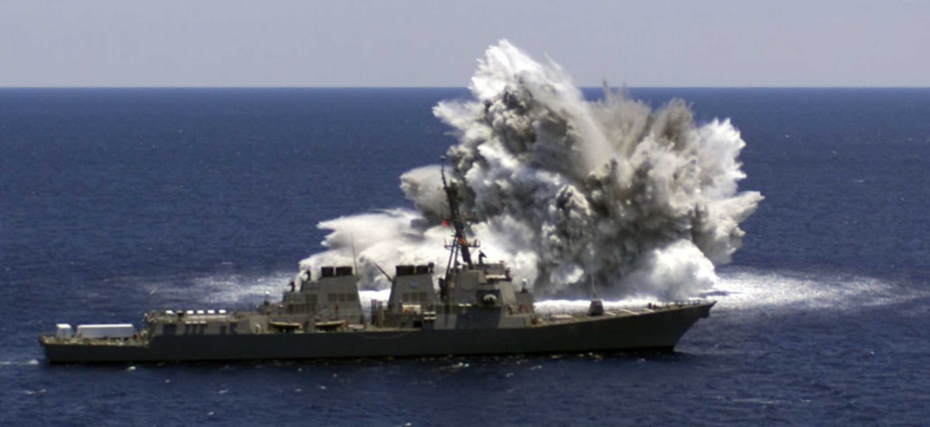
TYPICAL BLASTING PERCEPTION
13
SHIP-SHOCK OF USS WINSTON S CHURCHILL (PHOTO COURTESY OF NMFS-OPR)
Many think this image of a ship shock = confined blasting
THIS IS NOT THE CASE

Slide 14
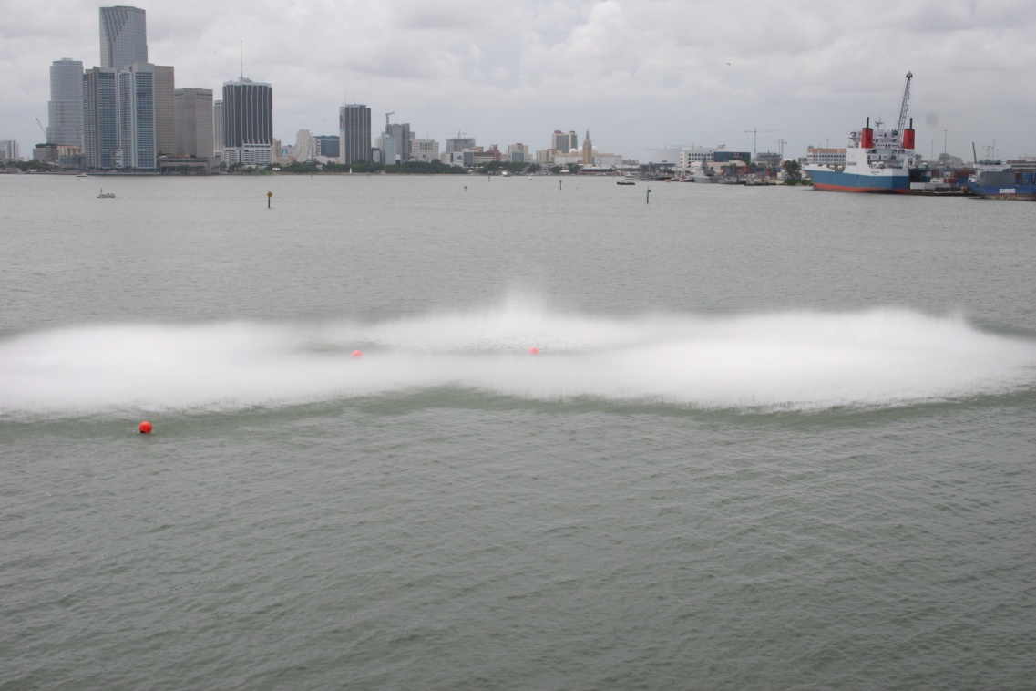
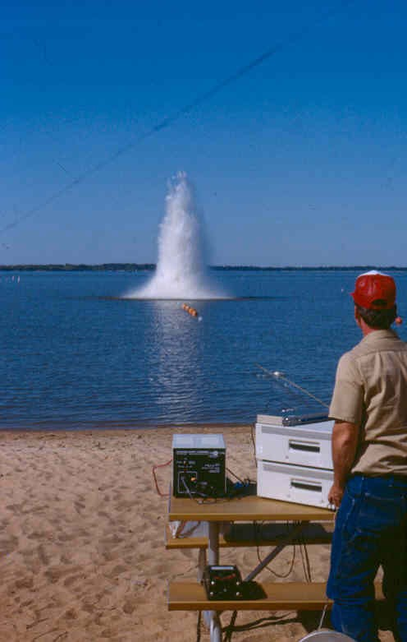
CONFINED vs. UNCONFINED BLASTING
14
7 pounds of explosives
UNCONFINED
3000 pounds of explosives
CONFINED
Notes:
Firecracker analogy – closed hand, open hand/ closed mailbox, open mailbox
Unconfined blast – a blast where the pressure is allowed to escape into the sounding environment (water)
In confined blasting, a methodology used in Florida since the 1980s, the hole in which the explosive material is placed is capped with an inert material, such as crushed rock.

Slide 15
15
=
Confined underwater blasting can be used as a successful and efficient construction technique to pre-treat and crack hard rock, and with minimal impacts
Notes:
Firecracker analogy – closed hand, open hand/ closed mailbox, open mailbox
Unconfined blast – a blast where the pressure is allowed to escape into the sounding environment (water)
In confined blasting, a methodology used in Florida since the 1980s, the hole in which the explosive material is placed is capped with an inert material, such as crushed rock.

Slide 16
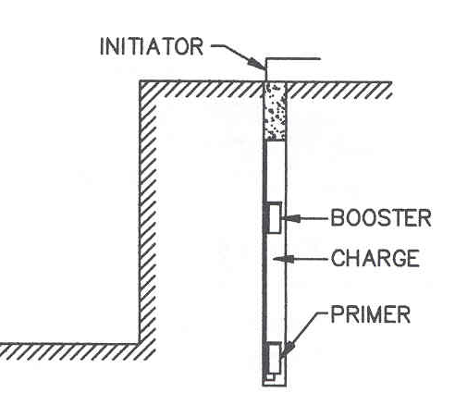
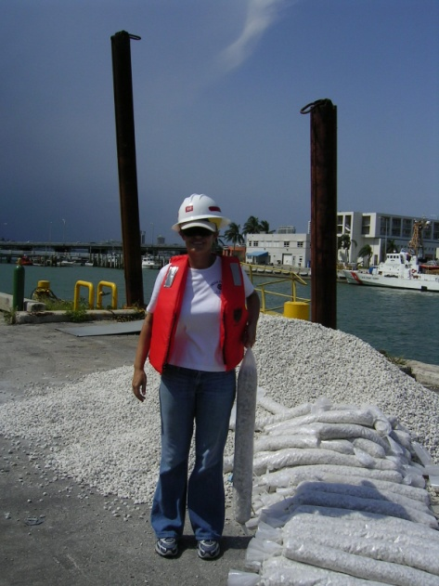
BLASTING OVERVIEW
16
STEMMING
MATERIAL
Pressure Reduction ≥ 90%
Smaller impact area
Notes:
Stemming – stemming is the material placed in the mouth of the drillhole to restrict the gas escape during the detonation.
Results in a reduction of pressure between 60-90%
This is referred to as “stemming the hole.” Studies have shown that stemmed blasts have up to a 90% decrease in the strength of the pressure wave released, compared to unconfined blasts of the same charge weight.

Slide 17
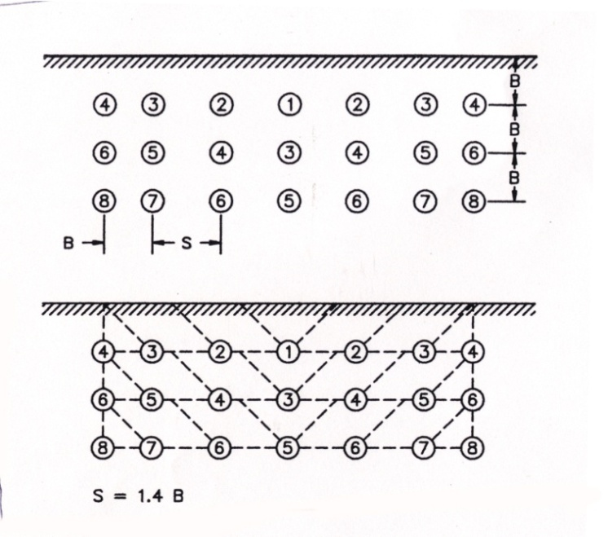
BLASTING OVERVIEW
17
Delays
One “shot”
Channel closed 15 minutes before blast
“All-Clear”
Notes:
Delay – a time delay (usually measured in milliseconds) that breaks up a larger blast into small component blasts – if enough time is put between the component shots (more than 8 milliseconds) the pressure intensity is also broken into small components that have less impact that the total shot weight, had it been fired all at once. Example – August 2 – total lb weight of shot – 1105 lbs, broken into 16 delays – max wt/delay – 67 lbs.

Slide 18
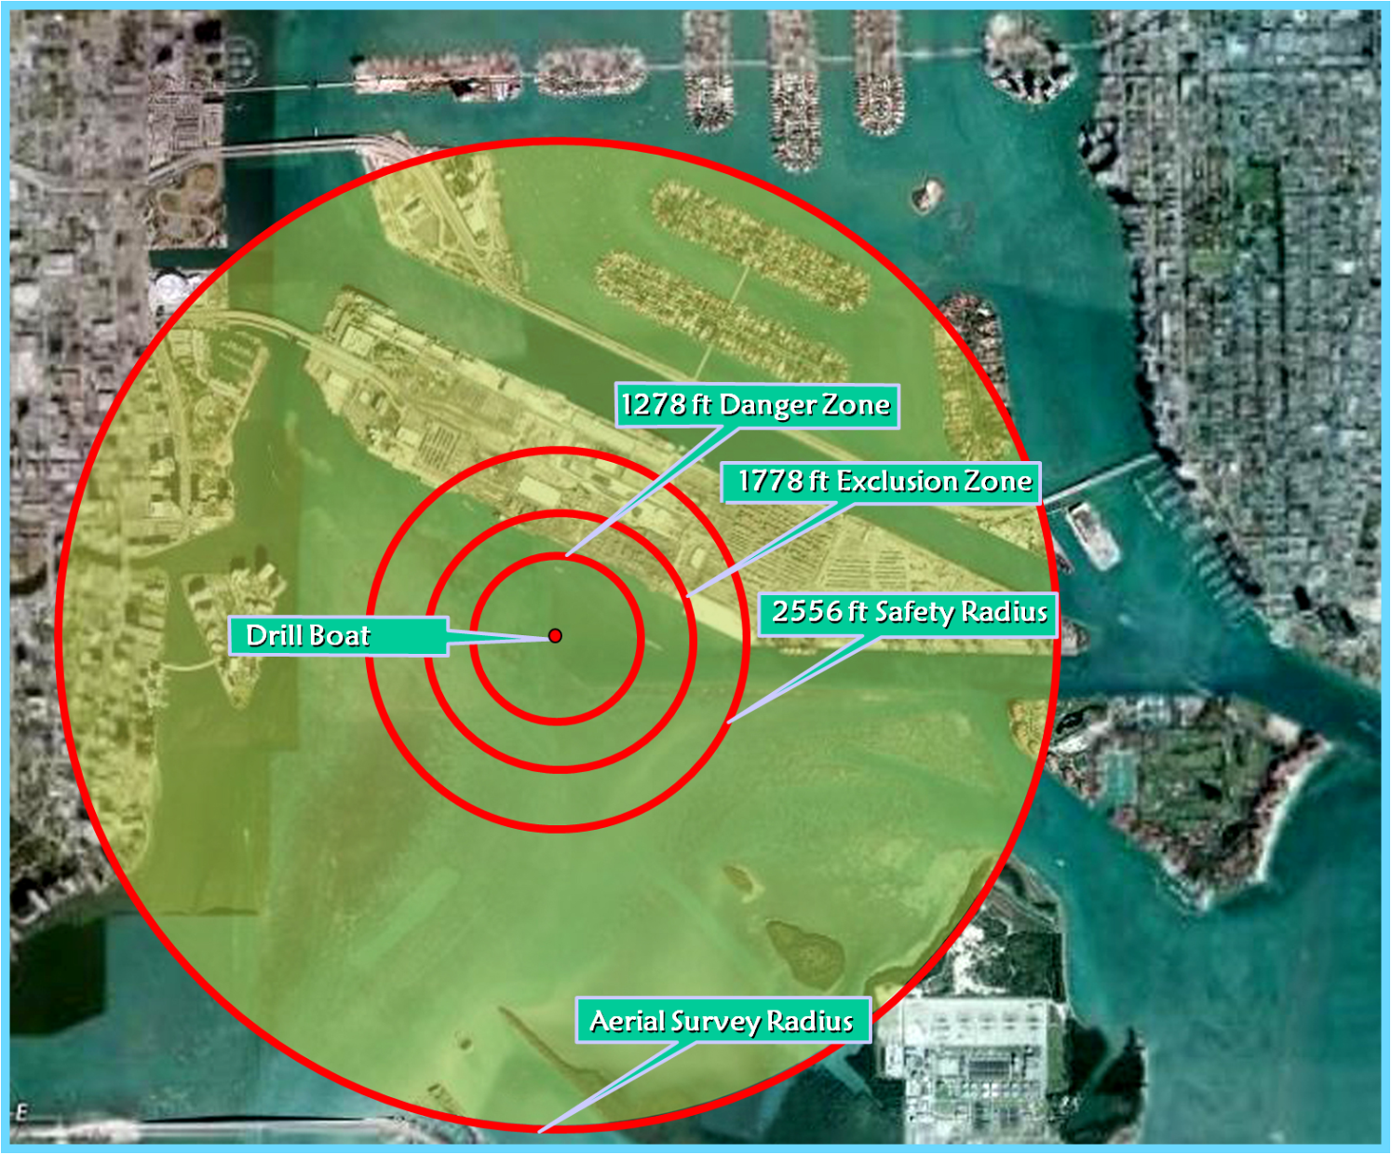
MONITORING ZONES
18
Average Zone Configuration for USACE Standard Underwater Blasting
R = 260 (cube root W)
R = Safety Radius
W = Weight of explosives
Danger Zone Radius = 260 (lbs/delay)
Safety Zone Radius = 520 (lbs/delay)
Watch Zone Radius = 3[260 (lbs/delay) ]
RADIUS CONFIGURATION FORMULA
1/3
1/3
1/3
Notes:
As part of the blast plan, a safety radius for marine mammals and turtles had to be calculated to determine the distance from the blast at which harassment or injury to protected marine species is likely to occur. This safety radius is determined by the amount of explosives used within each delay (which can contain multiple boreholes). These calculations are based on human impacts when exposed to a detonation suspended in the water column (unconfined blast) as researched by the Navy in the 1970s and the British Navy in the 1980s. Due to the nature of the confined blast and the probable sensitivity differences between humans and marine mammals, it is believed that this radius is a conservative, but prudent, approach to the protection of marine wildlife species. The zone calculations are done in a tiered approach based on level of impact and mitigative procedures.
The calculations are as follows:
1) Danger Zone: The radius whose outer limit represents the minimum distance for no expected mortality. The danger zone (ft) = 260 (the cube root of weight of explosives in lbs per delay)
2) The safety zone is a larger radius to insure species are beyond the minimum distance whereby Level A harassment may occur, typically beyond the 180db isopleths. The exclusion zone (ft) = 520 (cube root of weight of explosives in lbs per delay)
3) The watch Zone is the radius of the danger zone *3 to insure animals entering or traveling close to the safety zone are spotted and appropriate actions can be implemented before or as they enter any impact areas. Animals in the safety zone are closely monitored to insure they do not enter the exclusion zone.
Explosive weights ranged from 17 lbs to 376 lbs per delay with the average explosive weight 119lbs per delay giving the typical zone distances of:
Danger zone =1278
Exclusion zone = 1778
Safety zone = 2556
The above distances were used for conducting the watch program during all blasts unless the watch coordinator was informed that the blast weight was over 120lbs.
1 hour before the blast aerial survey and 30 minutes after the blast waiting period

Slide 19
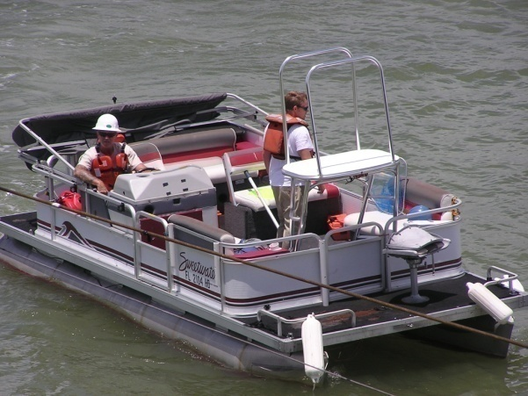
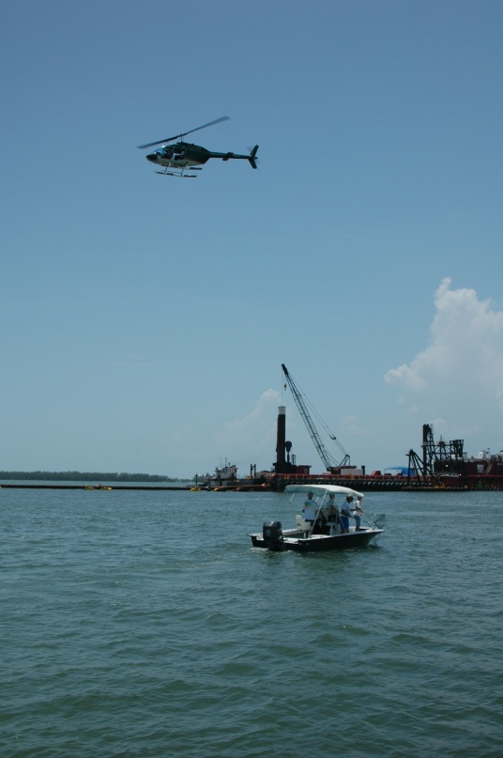
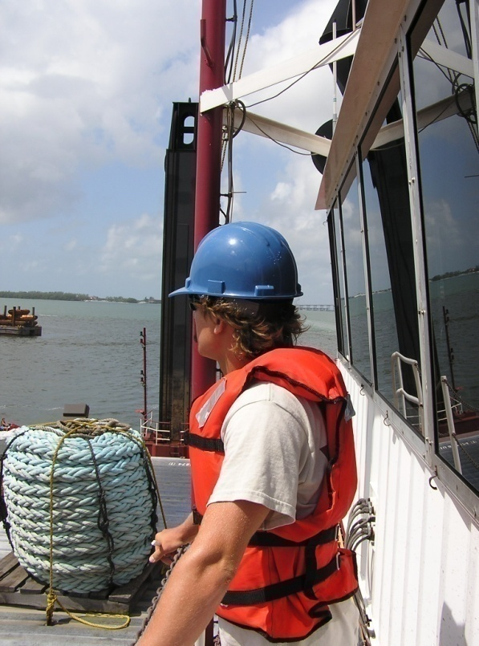
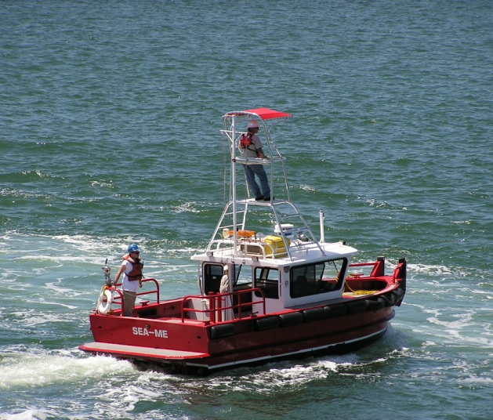
MONITORING METHODS
19
Observation Techniques and Data Collection
Two small boats on water – east and west of drill barge
Aerial
Drill barge
Notes:
A watch plan was formulated based on the required safety zones and optimal observation locations. The watch plan consisted of 6 observers which included at least 1 aerial observer, 2 boat-based observers, and 2 observers stationed on the drill barge. The 6th observer was placed in the most optimal observation location (boat, barge or aircraft) on a day by day basis depending on the location of the blast and the placement of dredging equipment. This process helped to insure complete coverage of the safety zone and critical areas. The watch began at least 1 hour prior to blast and continued for one-half hour after the blast.
The aerial observer flew in a turbine engine helicopter (bell jet ranger) with doors removed. This provided maximum visibility of the safety zone as well as exceptional maneuverability and the needed flexibility for continual surveillance without fuel stops or down time, minimization of delays due to weather or visibility and the ability to deliver post-blast assistance. The survey radius for the aerial crew was roughly three times the safety zone as required by standard observation conditions set by NOAA and FWS.
Boat-based observers were placed on one of two vessels, both of which had attached platforms that place the observers at least 3 meters above the water surface enabling optimal visibility of the water from the vessels.
The drill barge observers were in place on the catwalk of the control tower approximately 30 ft above the water. One observer faced the blast array while the other faced away from the blast. This site is a critical site for observers as it not only gives an excellent view of the most critical impact zone, it also serves as back up communications between the aerial observer and the blaster in charge.

Slide 20
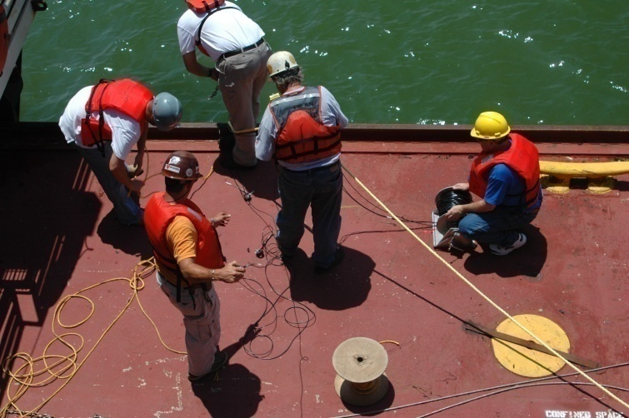
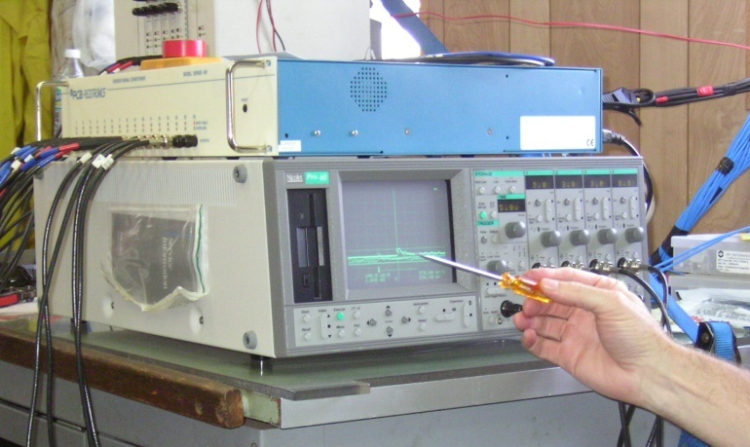
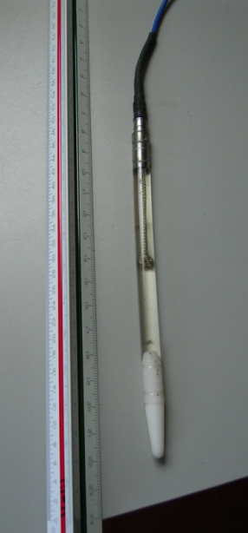
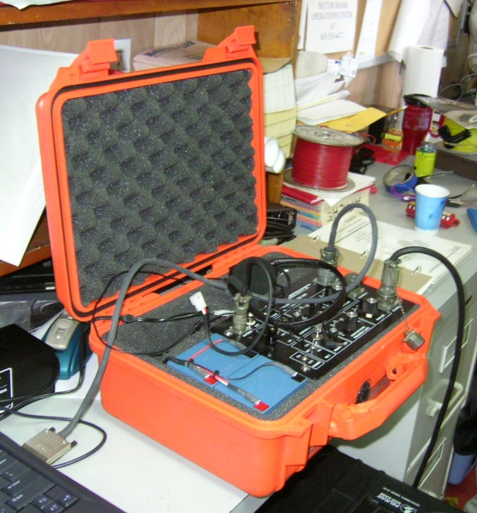
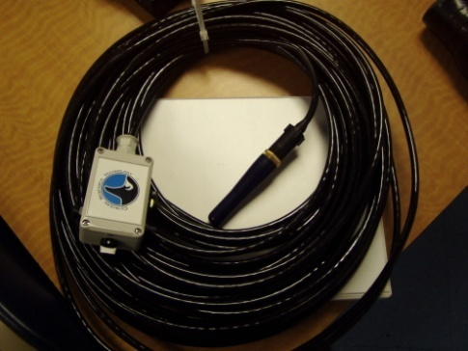
ACOUSTIC/PRESSURE MONITORING
20
Lowering transducers into water
Oscilloscope
Hydrophone
Pressure Transducer

Slide 21
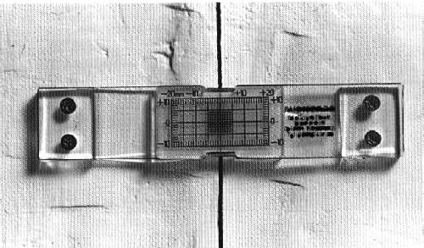
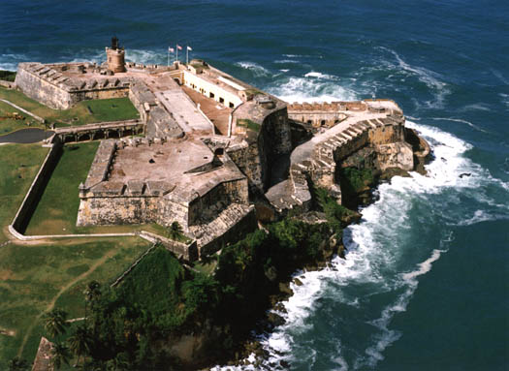
SEISMIC/VIBRATION MONITORING
21
In an urban environment, such as the port, which is surrounded by commercial properties, utilities, and residential communities, protection of structures must be considered
Once areas of the project requiring blasting have been identified, critical structures within the blast zones would be determined
Where vibration damage may occur, energy ratios and peak particle velocities shall be limited in accordance with state or county requirements, whichever is more stringent
Notes:
Picture: San Juan, PR

Slide 22
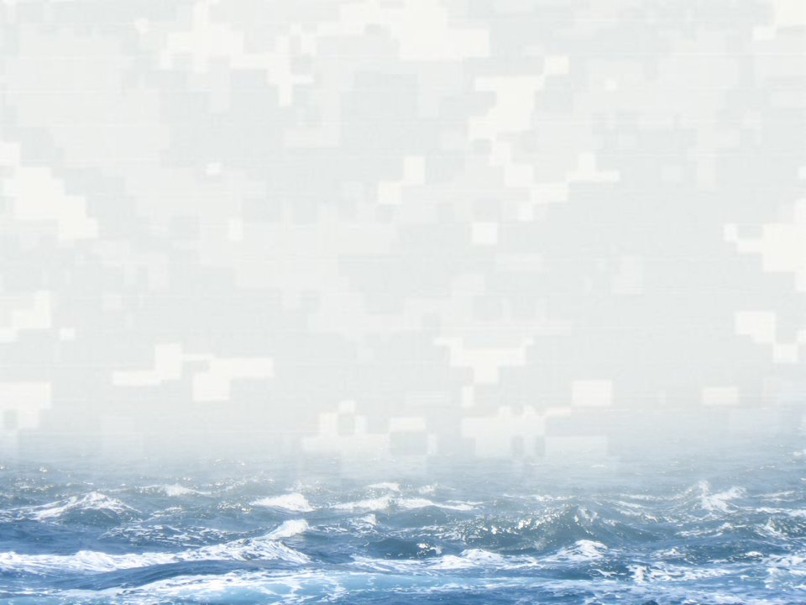
RECORDINGS OF A BLAST
22
August 2, 2005 - 16 Holes; 67 lbs/delay; 16 delays; 1105 lbs of explosive
BUILDING STRONG®
BUILDING STRONG®
US ARMY CORPS OF ENGINEERS | Jacksonville District
US ARMY CORPS OF ENGINEERS | Jacksonville District

Slide 23
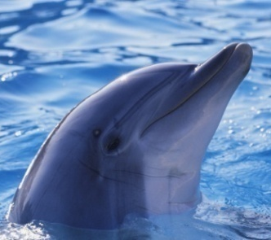
RESULTS: ANIMALS OBSERVED AND DELAYS
186 ANIMALS OBSERVED
13 DELAYS TO ENSURE ANIMAL SAFETY
AVERAGE DISTANCE OBSERVED FROM ARRAY
58 dolphins
4
(31% of total delays)
2000 feet
110 Manatees
4
(31% of total delays)
3500 feet
16 Sea Turtles
5
(38% of total delays)
500 feet
40 “Shots” in 38 days between June through August 2005
Notes:
Blasting began on 25 June and was completed on 12 August for a total of 38 days of blasting for 40 blasting events (3 days had 2 blasts).
All turtles that could be id’ed to species were loggerheads and it is believed that remaining turtles were likely loggerheads as well

Slide 24
BLASTING EFFECTS: MARINE MAMMALS
24
450 POUND UNCONFINED BLAST
ZONE | MAX PRESSURE | LOCATION | NMFS TAKE THRESHOLD | LETHAL/ INJUROUS TAKE? | HARRASSMENT?
Danger Zone | 23 psi | 700 feet from blast | 22 psi | No | Yes
Safety Zone | <23 psi | within zone | 22 psi | No | No
NMFS: National Marine Fisheries Service
Notes:
The Corps will request authorization of incidental taking by Level B harassment only, acoustic harassment associated with blasting activities.
For an open-water, non-confined blast, the pressure at the edge of the Danger Zone will be 23 psi (equal to NMFS harassment criteria). For a fully confined detonation, the pressure at the edge of the Danger Zone will be 6 psi. Utilizing the pressure data collected from Phase II, for a maximum charge weight of 450 lbs in a fully confined blast, 700 feet from the blast the pressure would be 22 psi. However, to ensure the protection of animals, and in case of a detonation that is not fully confined, the Corps assumes that any animal within the boundaries of the Danger Zone would be taken by level B Harassment.
If animals remain outside of the Danger Zone, then no take will occur, because pressures will be significantly below the level of pressure deemed to be impactive by NMFS under the dual criteria (23psi).
With regard to prey species (for dolphins), a very small number of fish are expected to be killed by the blasting.
USACE will pursue an IHA from NMFS for potential harassment effects for bottlenose dolphins from NMFS-OPR (Silver Spring) prior to contract advertisement. Similar experience with Miami Harbor Phase II in 2005 and current Miami Harbor project.

Slide 25
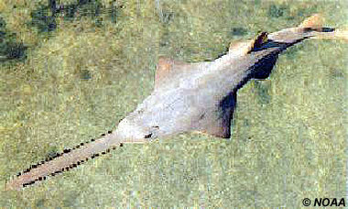
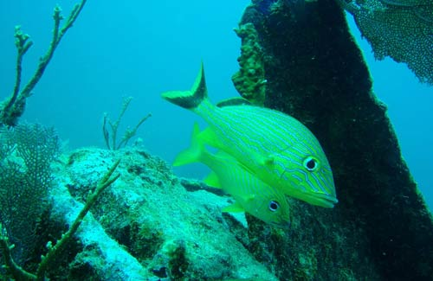
Blasting Effects: Fish Species
25
NO SWIMBLADDER:
No effect to fishes without swimbladders - sawfishes (rays) and sharks
SWIMBLADDER:
Pressure resulting in impacts to fishes with swimbladders
The safe distance for fish (14-psi peak pressure) from a confined shot of 90 lbs/delay to fracture rock for channel deepening would be 570 feet. Fish within this 570-foot range would likely survive, considering the observations of Hubbs and Rechnitzer (1952) and Keevin (1995).
TYPE | PRESSURE | WHO
OPEN WATER * | 14 psi | Wright & Hopsky (1998) Canadian Department of Fish & Oceans
OPEN WATER * | 40-70 psi | Hubbs & Rechnitzer (1952)
OPEN WATER * | 50 psi | Keevin (1995)
CONFINED ** | 14 psi | Hemper (2008)
Without Swimbladder
* 260 w^{1/3} ** 51 w^{1/3}
With Swimbladder
Notes:
No Swimbladder :
No effect to fishes that lack swimbladders – sawfishes (rays) and sharks.
Swimbladder:
The Canadian Department of Fisheries and Oceans uses the value of 14 psi as the overpressure (peak pressure) that is safe for fish with swimbladders (Wright and Hopky, 1998). This extremely conservative Canadian value is used as the peak pressure to resolve safe distance for fish from charge weight per delay. Hubbs and Rechnitzer (1952) determined that the lethal threshold peak pressure for a variety of marine fish species exposed to dynamite blasts varied from 40 psi to 70 psi. Keevin (1995) determined that bluegill (Lepomis macarchirus), a highly blast susceptible fish species with a thin swimbladder, experience no internal damage or mortality at approximately 50-psi peak pressure.
The safe distance (or range) from underwater blasting is related to the conservative 14-psi overpressure. Note that this is related to the peak value, not the tensile portion of the wave. [Greater peak amplitudes are likely related to longer periods of tensile pressures.] For open-water shots, the equation to determine the distance at which 14 psi occurs may be determined from Cole’s (1948) or USACE’s (1991) equations for open-water charges. The equation for the safe distance for open-water shots, D_{o} , may be written as:
D_{o}(ft) = 260 W^{1/3} - for the charge weight per delay, W, in lbs.
For confined (stemmed borehole shots), based on data presented in Hempen et al. (2007), the equation to determine the safe distance from confined shots, D_{c} , at which 14 psi occurs is:
D_{c} (ft) = 51 W^{1/3} - for the charge weight per delay, W, in lbs.
The safe distance for fish (14-psi peak pressure) from a confined shot of 90 lb/d to fracture rock for channel deepening would be 570 feet. Fish well within this 570-foot range would likely survive, considering the observations of Hubbs and Rechnitzer (1952) and Keevin (1995).

Slide 26
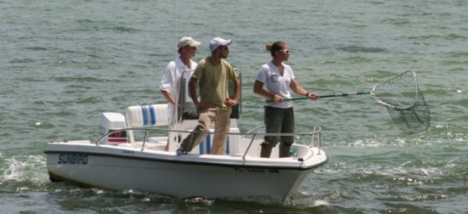
RESULTS OF MONITORING: FISH
26
40 “shots” from June 25 through August 12, 2005
Fish scare to lessen impact
23 w/fish impact monitoring by FWC
Average fish recovered per blast: 14 (*Range 3-38)
No commercially or recreationally targeted species collected (e.g., snook, tarpon)
Fish Scare Clip
Notes:
With regard to prey species (mainly fish), a very small number of fish are expected to be impacted by the Miami Harbor project, based on the results of the 2005 blasting project in Miami Harbor. That project consisted of 40 confined blast events over a 38 day time frame. Of these 40 confined blast events, 23 were monitored (57.5% of the total) by the State and injured and dead fish were collected after the all clear was given (the “all-clear” is normally at least two to three min after the shot is fired, since seagulls and frigate birds quickly learned to approach the confined blast site and swoop in to eat some of the stunned, injured, and dead fish floating on the surface of the water). State biologists and volunteers collected the carcasses of the floating fish (note that not all dead fish float after a blasting event, and due to safety concerns, there are no plans to put divers on the bottom of the channel in the blast zone to collect non-floating fish carcasses. The fish were described to the lowest taxonomic level possible (usually species) and the injury types were categorized.
A summary of those data shows that 24 different genera were collected during the previous Miami Harbor blasting project. The species with the highest abundance were white grunts (Haemulon plumier, N = 51), scrawled cowfish (Lactophrys quadricornis, N = 43), and pygmy filefish (Monocanthus setifer, N = 30). The total fish collected during the 23 confined blasts was 288 or an average of 12.5 fish per blast (range 3 to 38). In observation of the three confined blasts with the greatest number of fish killed (see Table 4 of ACOE’s application) and reviewing the maximum charge weight per delay for the Miami Harbor project, it appears that there is no direct correlation between the charge weight and fish killed that can be determined from such a small sample. Reviewing the 23 confined blasting events where dead and injured fish were collected after the “all-clear” signal was given, no discernable pattern exists. Factors that affect fish mortality include, but are not limited to fish size, body shape (fusiform, etc.), proximity of the blast to a vertical structure like a bulkhead (e.g., see the August 10, 2005 blast event, a much smaller charge weight resulted in a higher fish kill due to the closeness of a bulkhead).
In the past, to reduce the potential for fish to be injured or killed by the confined blasting, the resource agencies have requested, and ACOE has allowed that confined blasting contractors utilize a small, unconfined explosive charge, usually a 1 lb (0.5 kg) booster, detonated about 30 seconds before the main confined blast, to drive fish away from the confined blasting zone. It is assumed that noise or pressure generated by the small charge will drive fish from the immediate area, thereby reducing impacts from the larger and potentially more-damaging confined blast. Blasting companies use this method as a “good faith effort” to reduce the potential impacts to aquatic natural resources. The explosives industry recommends firing a “warning shot” to frighten fish out of the area before seismic exploration work is begun (Anonymous, 1978 in Keevin et al., 1997).
These results call into question the true effectiveness of this minimization methodology; however, some argue that based on the monetary value of fish (American Fishery Society, 1992 in Keevin et al., 1997), including the high value commercial or recreational species like snook (Centropomus undecimalis) and tarpon (Megalops atlanticus) found in southeast Florida inlets like Port Everglades, the low cost associated with repelling charge use would be offset if only a few fish moved from the kill zone (Keevin et al., 1997).

Slide 27
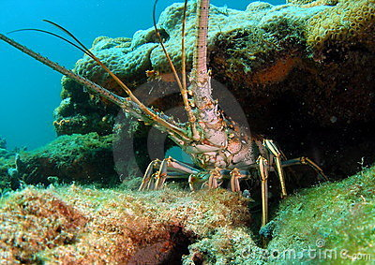
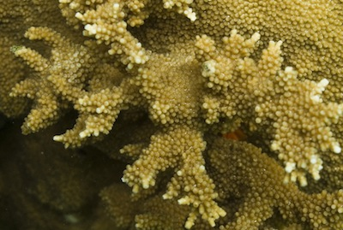
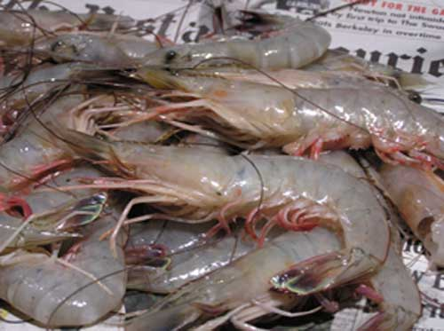
BLASTING EFFECTS: INVERTEBRATES
27
A literature review of the effects of open-water blasts on invertebrates (including corals and arthropods) by Keevin and Hempen (1997) states:
NMFS has previously concurred with this determination at Miami Harbor (2011)
The results of all the studies reviewed indicate that invertebrates are insensitive to pressure related damage from underwater explosions. This may be due to the fact that all the invertebrate species tested lack gas-containing organs which have been implicated in internal damage and mortality in vertebrates. Underwater explosion produce a pressure waveform with rapid oscillations from positive pressure to negative pressure which results in rapid volume changes in gas-containing organs. Species lacking swimbladders or with small swimbladders are highly resistant to explosive pressures (Aplin 1947; Fitch and Young 1948; Goertner 1994).

Slide 28
COMMUNICATION AND COORDINATION TEAM
Corps of Engineers – Jacksonville District
Port of Miami/Miami-Dade County
Contractor and sub-contractors
Federal Resource agencies (FWS, NMFS, EPA)
State Resource agencies (DEP, FWC, CAMA)
Local Resource agencies (DERM/PERA)
Non-governmental organizations (NGOs)

Slide 29
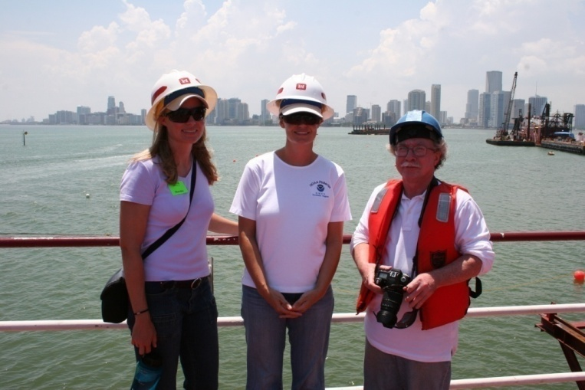
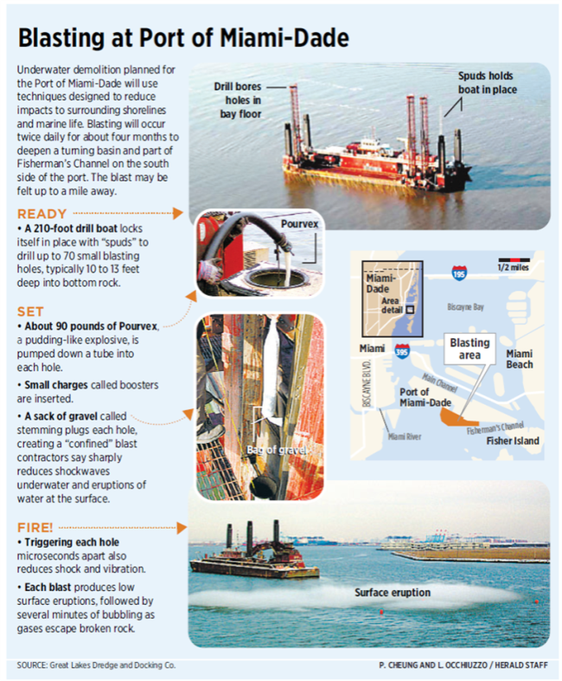
COMMUNICATION AND COORDINATION
Blasting Workshop to teach resource agency staff about blasting
On site with experts (biologist/geophysicist)
Blasting workshop for the public hosted by contractor
Visits to the worksite by resource agencies and interested parties (including the press)

Slide 30
MONTHLY MEETINGS ONSITE
Held in Miami
More convenient location for most stakeholders
Conference call ability for those unable to travel
Reviewed project progress and previewed upcoming events
Made a major difference for all parties: maintained open communication lines between agencies/stakeholders, contractors, and Corps

Slide 31
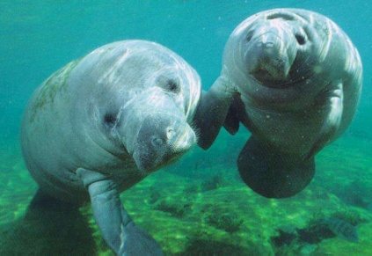
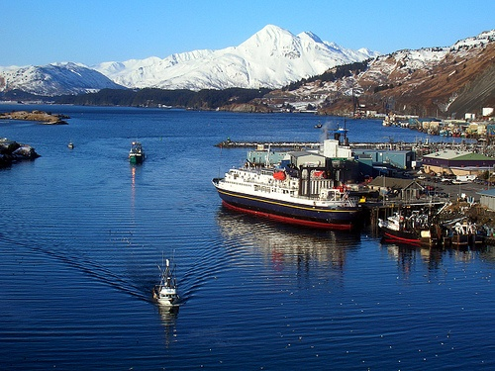
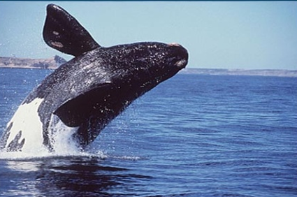
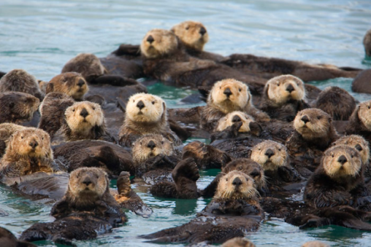
WORKING TO ANSWER QUESTIONS
Confined underwater blasting is “newer” to the resource agencies than unconfined (military ordnance)
As a result of Phase II, there is now a large database of information regarding confined blasting, to successfully implement future confined blasting programs in equally sensitive areas
Kodiak Harbor, AK

Slide 32
PUBLISHED, PEER-REVIEWED LITERATURE AND PRESENTATIONS
Hempen, G., T. Keevin and T. Jordan. 2007. "Underwater Blast Pressures from Confined Rock Removal during the Miami Harbor Deepening Project.” Feb 2007.
Jordan, T.L., K.R. Hollingshead and M.J. Barkaszi. 2007. “Port of Miami Project. Protecting Marine Species During Underwater Blasting.” Feb 2007
The Ocean Sciences Conference – special session on acoustics – Honolulu, HI – Feb 2006
16th Biennial Conf on the Biology of Marine Mammals – San Diego, CA - Dec 2005
15th Biennial Conf on the Biology of Marine Mammals – Greensboro, NC - Dec 2003
Press articles and interviews – National Public Radio; Comcast Newsmakers; USA Today; Miami Herald; Jacksonville Times-Union

Slide 33
CONCLUSIONS
Confined underwater blasting can be used as a construction technique to crack rock, with minimal impacts to marine organisms living in the project area when proper monitoring and safety precautions are established protocols from the beginning of project planning
=
BUILDING STRONG®
BUILDING STRONG®
US ARMY CORPS OF ENGINEERS | Jacksonville District
US ARMY CORPS OF ENGINEERS | Jacksonville District

